Slide 1
CSE 8A – Introduction to Programming and Computational Problem Solving I
CS1-LLMs Materials © 2023 by Leo Porter, Dan Zingaro, and Christine Alvarado is licensed under CC BY-NC-SA 4.0
A Largish Software Example:
Markov Text Generation
How to get help:
Class Website
https://sites.google.com/ucsd.edu/cse8afa23/home
Piazza for brief questions or logistic questions
Tutor Hours for help with homework/setting up computer To get help, use Autograder (directions on piazza)
Office Hours for homework/conceptual help
Slides based, in part, on materials from Dan Zingaro and Christine Alvarado.
Notes:
Welcome!
Setup starting code in folder:
# Read a text and remember the words and what comes after them in a dict
f = open(input("Training text: "))
d = make_dictionary(f)
print(d)
f.close()
print(mimic_text(d, 100))

Slide 2
Announcements
Reading Quiz 8 due next Tuesday at noon
Short reading on images
Homework 6 due Monday at 10pm
Lab 6 tomorrow – testing!
Quiz 2 homework retake – due today at 10pm.
One attempt, must be done in one sitting!
Project 1 – Full version due next Thursday.
Have fun! Copilot strongly recommended.
Project 2 – Images
We cover image tomorrow
Survey!!!!!

Slide 3
Did you know that Copilot can explain code?
Quick demo in VSCode
Notes:
You all have different personal experiences. I can’t adjudicate fairness in the world and the playing field is never level. Remember that we all have our own personal struggles and do your best.

Slide 4
Learning Goals for Today
By the end of today’s lecture, you should be able to:
Use Dictionaries, Testing, and Problem Decomposition to perform Markov Text Generation

Slide 5
Markov Text Generation
Let’s create text that appears/sounds like it came from a different source (this is a precursor to LLMs)
Plan:
- Discuss the idea
- Do some small sample questions
- Code up a larger example together

Slide 6
Review: Predicting the future: Markov processes
Current State

Slide 7
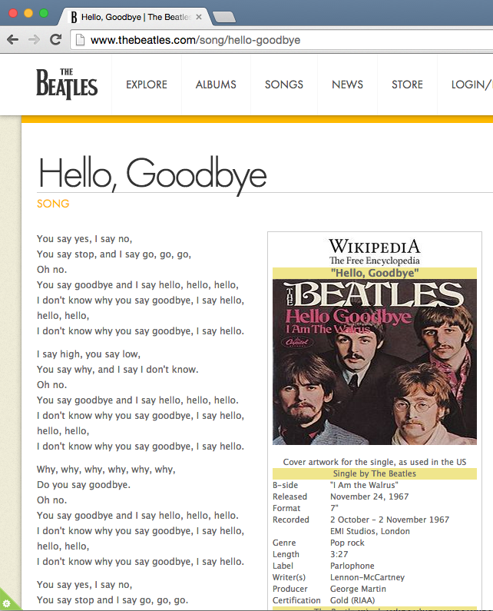

Slide 8
Early Idea
Build the model (create dictionary):
The “context” will be the previous word (starts as ' ' )
Associate each “context” with a list of the words that follow it
The “context” becomes the current word

Slide 9
What is the dictionary that should be created for the text:
this is this was
{'': 'this', 'this': 'is', 'is': 'this', 'this': 'was’}
{'': ['this'], 'this': ['is', 'was'], 'is': ['this’]}
{'': ['this'], 'this': ['is', 'was'], 'is': ['was’]}
{'': 'this', 'this': 'is', 'is': 'this'}
Notes:
{'': ['this'], 'this': ['is', 'was'], 'is': ['this’]}

Slide 10
What about probabilities?
Stage 2: Generate
word
"hello."
I
nextWords
"I" , "I" , "Why," , "I" , "You" , "You"
3/6
hello.
1/6
Why,
2/6
Just Pick Randomly from the List!
You
Notes:
"You" always followed by "say"

Slide 11
Stage 2: Generate
General Idea:
Until we have enough words:
Find current word as the key in our dictionary and get back the list of nextWords as a value
Generate a random number between 0 and the size of the nextWords list of this node
Select the word at that index in nextWords
Repeat
Notes:
"You" always followed by "say"

Slide 12
Let’s build this!
We know what data structure we want to use
We’ve worked through a couple concrete examples
Next steps:
Determine how to test the code
Let’s try building some of our functions and then see if problem decomposition makes sense
Two core functions are (let’s review quickly):
make_dictionary(file)
mimic_text(word_dict, num_words)

Slide 13
make_dictionary(file)
Input: Let’s take in an open file handle (or filename, our choice)
Output: A dictionary representing the text (as described above)

Slide 14
mimic_text(word_dict, num_words)
Input: A dictionary representing a text (string->list). The number of words to output.
Output: A generated string mimicking the text represented by the dictionary.

Slide 15
Testing (Part 1)
How should we test our code? (What’s the best answer?)
Let’s write our build_dictionary and mimic_text functions. Then build the dictionary using a large file and start generating text. Then see if the text we get back seems reasonable.
Let’s write our build_dictionary function using a large file, then figure out if the dictionary it built seems reasonable.
Let’s write our build_dictionary function using a small file and compare it against the correct version of the dictionary based on us figuring out what should be in the dictionary by hand.
Let’s write a function compare_dictionaries that can compare the contents of two dictionaries to see if they are the same. Let’s test that function. Then, let’s write our build_dictionary function using a small file, comparing it to the correct dictionary using our compare_dictionaries function.
Notes:
C is the best answer. No need to overdo things with the function just to compare dictionary equality.
D isn’t directly wrong, but is a bit of overkill. This seems unnecessary. Technically you could do this, and it might help with auto-testing, and you could even handle weird things like people sorting lists.

Slide 16
Testing (Part 2)
What’s a interesting text to use for comprehensive testing, both for testing the build_dictionary and mimic_text functions? (select the best option)
“I like cats."
“I like cats. I like cats."
"I like cats. I like dogs."
'You say, "Yes", I say, "No“ You say, "Stop" and I say, "Go, go, go“ Oh, no! You say, "Goodbye" and I say, "Hello, hello, hello“ I don't know why you say, "Goodbye", I say, "Hello, hello, hello“ I don't know why you say, "Goodbye", I say, "Hello" ‘
Notes:
A no repeated words, okay starting point. No randomness, can’t test 3 words.
B would be fine for the dictionary building but not for the mimic_text part… That leads us to C.
C is good, let’s us test randomness, may even want something slightly more complicated so we can see text that’s not in the original.
We need to have a word that is only followed by the same word. We want a word that is followed by a different word so we can see if it’s picking different words when mimicking. So that eliminates A and B. has D is huge, I don’t want to build that by hand.

Slide 17
Rules for good testing
Cover the common case(s)
Cover end cases that might cause unexpected behavior
Don’t be repetitive
If you have a function that adds to numbers:
Adding positive to positive, negative to positive, positive to zero, etc. are interesting
But testing 3+6 and 7+8 is unnecessary, you know it works for positive integers already
Careful, Copilot can be redundant in its test cases
Generally speaking:
Don’t write code until you know how you’ll test it
Only write more code once you’ve tested the initial code

Slide 18
Example: Given the text below, build the dictionary (Slightly more interesting test case)
"I like my cat. I like to see my dog. My dog likes to see me."
Notes:
This is slightly more advanced. Probably your 4th or 5th test case.
{'': ['I’],
'I': ['like', 'like’],
'like': ['my', 'to’],
'my': ['cat.', 'dog.’],
'cat.': ['I’],
'to': ['see', 'see’],
'see': ['my', 'me.’],
'dog.': ['My’],
'My': ['dog’],
'dog': ['likes’],
'likes': ['to']}

Slide 19
Example: Given the text below, build the dictionary
"I like my cat. I like to see my dog. My dog likes to see me."
Which of the following Strings could not have been created with the text above?
I like to see my cat.
I like to see me.
I like my cat.
My dog likes to see my cat.
All of the above are possible.
Notes:
All are possible

Slide 20
Why we work through examples ourselves
If you can’t do it yourself by hand, you absolutely cannot code it
If it’s too complex, you’ll likely find ways to break it into smaller problems (which you’ll need to do when designing the code)
Working through examples helps give us insight into how we might code it and test it
Especially true as problems get harder
Bottom line: Don’t try to start coding if you don’t already know what you plan to code and how to test it.

Slide 21
make_dictionary(file)
Input: Let’s take in an open file handle (or filename, our choice)
Output: A dictionary representing the text (as described above)
Idea:
The context will be the previous word (starts as '')
Associate each context with its list of words
The context becomes the current word
Notes:
Walk through the idea:
Starting Code:
# Read a text and remember the words and what comes after them in a dict
f = open(input("Training text: "))
d = make_dictionary(f)
print(d)
f.close()
print(mimic_text(d, 100))

Slide 22
Code together: make_dictionary(file)
Input: Let’s take in an open file handle (or filename, our choice)
Output: A dictionary representing the text (as described above)
Idea:
The context will be the previous word (starts as '')
Associate each context with its list of words
The context becomes the current word
Notes:
def make_dictionary(f):
'''
Return a dictionary where the keys are words in f and the value
for a key is the list of words that were found to follow the key in f.
'''
dct = {}
context = ''
line = f.readline()
while line:
words = line.split()
for word in words: ← STOP HERE
if context in dct:
dct[context].append(word)
else:
dct[context] = [word]
context = word
line = f.readline()
return dct

Slide 23
What’s next?
def make_dictionary(f):
dct = {}
context = ''
line = f.readline()
while line:
words = line.split()
for word in words:
What’s the best next line?
if context in dct:
if word in dct:
dct[context] = word
dct[word] = word
None of the above
Notes:
If context in dct: We need to know if the context is in the dct and then add it. Then finish the code live coding and compare the dictionary you build against the one they built by hand.
def make_dictionary(f):
'''
Return a dictionary where the keys are words in f and the value
for a key is the list of words that were found to follow the key in f.
'''
dct = {}
context = ''
line = f.readline()
while line:
words = line.split()
for word in words:
if context in dct:
dct[context].append(word)
else:
dct[context] = [word]
context = word
line = f.readline()
return dct

Slide 24
Should we have divided that up?
Which of the following might have been a nice helper function? (best answer)
# function to build a dictionary given a filename build_dictionary(filename):
# function to add a value to a key in a dictionary. If the key # is present, add the value to the list. Otherwise insert the # new key and assign it to have a list with just the value associate_pair(dct, key, value):
# function takes a line of text as input, splits the line, then # returns the list of words process_line(line):
None of the above
More than one of the above
Notes:
A is not a helper function at all, it’s just the same function.
B is pretty reasonable as it would clean up the inner loop and could help us do some more isolated testing. It might have value for other functions but possibly not. Interface is fairly clean, but does have a slightly specific use case of adding words to a list.
C is what split does anyway so weird to have a function with just a quick call to split

Slide 25
mimic_text(word_dict, num_words)
Input: A dictionary representing a text (string->list). The number of words to output.
Output: A generated string mimicking the text represented by the dictionary.
Idea:
Again context starts as ''
Look up the context in the dict; for now assume that the context is a key
Randomly choose from the context's value list
Append the chosen word to your story
The context becomes the chosen word
Notes:
def mimic_text(word_dict, num_words):
story = ''
context = ''
for i in range(0, num_words):
next_words = word_dict.get(context)
rand = random.randint(0, len(next_words) - 1)
story = story + ' ' + next_words[rand]
context = next_words[rand]
return story

Slide 26
Here’s what we have so far:
def mimic_text(word_dict, num_words):
story = ''
context = ''
for i in range(0, num_words):
next_words = word_dict.get(context)
rand = random.randint(0, len(next_words) - 1)
story = story + ' ' + next_words[rand]
context = next_words[rand]
return story
"I like my cat. I like to see my dog. My dog likes to see me."
“My dog likes to see me. I like my cat.“
Why is the generated text above not possible?
Notes:
We need to know if the context is in the dct and then add it. Then finish the code live coding and compare the dictionary you build against the one they built by hand.
def make_dictionary(f):
'''
Return a dictionary where the keys are words in f and the value
for a key is the list of words that were found to follow the key in f.
'''
dct = {}
context = ''
line = f.readline()
while line:
words = line.split()
for word in words:
if context in dct:
dct[context].append(word)
else:
dct[context] = [word]
context = word
line = f.readline()
return dct

Slide 27
Let’s fix that issue
def mimic_text(word_dict, num_words):
story = ''
context = ''
for i in range(0, num_words):
next_words = word_dict.get(context)
rand = random.randint(0, len(next_words) - 1)
story = story + ' ' + next_words[rand]
context = next_words[rand]
return story
Notes:
If next_words is None:
context = ‘’
next_words = word_dict.get(context)

Slide 28
Go farther!
Context is a single word, but if you make it multiple words, it’ll get better. (But too many words of context just repeats the source, so find a balance.)
Could use average/median list length as a measure of variation
Because we start with '' every time the text will always start with the first word in the source file. Could we randomly pick a different word?
Randomly pick a key from the dictionary?
Advanced, keep trying until you find a capitalized word at the start of the sentence, then run with that.
Notes:
You all have different personal experiences. I can’t adjudicate fairness in the world and the playing field is never level. Remember that we all have our own personal struggles and do your best.

Slide 29
Summary
Testing often requires creating your own test cases
Be sure to provide the broadest coverage possible
But keep it as short as possible (don’t be redundant)
For working with files, this often means making an example file
Code one function at a time, after you understand what it should do by solving it by hand.
Markov Text Prediction is a way of generating human-like language
Breaking up the task helped us code it successfully!

